Slide 1
NYC Parking Tickets: An Exploratory Analysis (Big Data)
Group Name:
Deepak Aneja
Suresh Balla
Merin Jose
Fayiz Mayam Veettil
25 Mar 2018

Slide 2
Table of Contents
Reading data into S3 (screenshot of the S3 bucket of all four members)
Exploratory Data Analysis
Examine Data
Aggregation Tasks

Slide 3
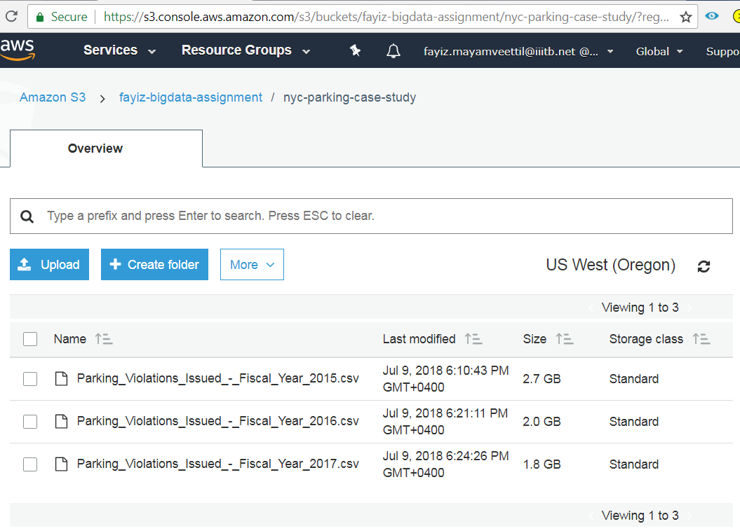
(Bucket Path : s3://fayiz-bigdata-assignment/nyc-parking-case-stud/)
S3 Bucket: Deepak Aneja (Bucket Path: s3://???????/nyc-parking-case-study/)

Slide 4
(Bucket Path : s3://fayiz-bigdata-assignment/nyc-parking-case-stud/)
S3 Bucket: Suresh Balla (Bucket Path: s3://data-science-big-data-analytics-suresh/nyc-parking-case-study/)

Slide 5
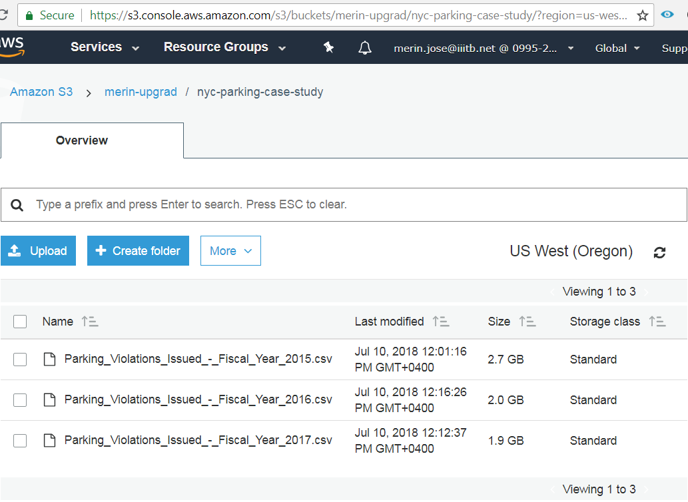
(Bucket Path : s3://fayiz-bigdata-assignment/nyc-parking-case-stud/)
S3 Bucket: Merin Jose (Bucket Path: s3://merin-upgrad/nyc-parking-case-study/)

Slide 6
(Bucket Path : s3://fayiz-bigdata-assignment/nyc-parking-case-stud/)
S3 Bucket: Fayiz Mayam Veettil (Bucket Path: s3://fayiz-bigdata-assignment/nyc-parking-case-study/)

Slide 7
Exploratory Data Analysis
Check for possible data inconsistencies
Check for duplicate records
Check for NA values in the columns used for analysis
Status of data cleaning
--

Slide 8
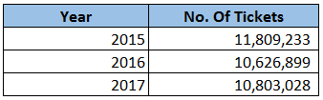
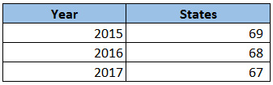
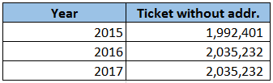
Examine the data
1. Find total number of tickets for each year.
2. How often does each vehicle body type get a parking ticket? How about the vehicle make? (find the top 5 for both)
3. Some parking tickets don’t have addresses on them, which is cause for concern. Find out how many such tickets there are.

Slide 9
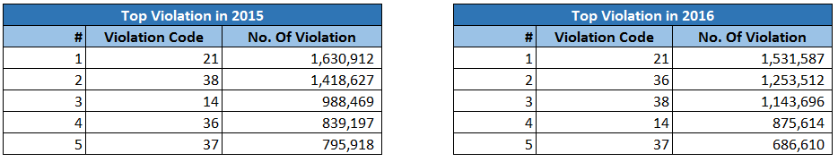
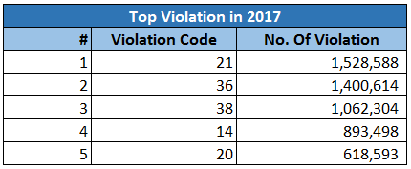
Aggregation Tasks
1. How often does each violation code occur? (frequency of violation codes - find the top 5)

Slide 10
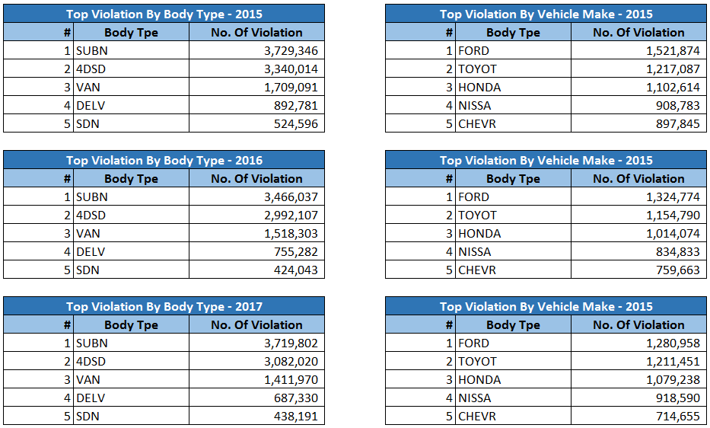
Aggregation Tasks
2. How often does each vehicle body type get a parking ticket? How about the vehicle make? (find the top 5 for both)

Slide 11
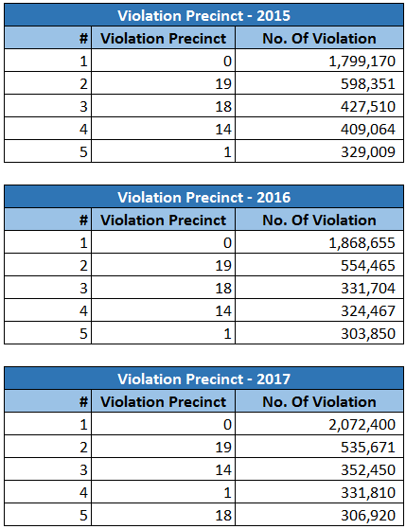
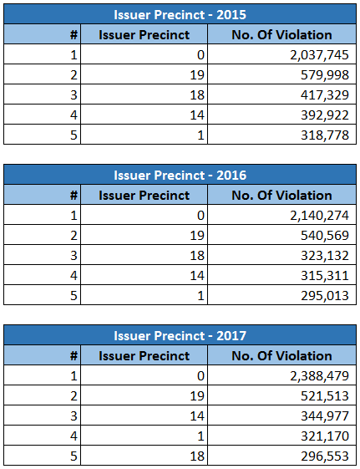
Aggregation Tasks
3. A precinct is a police station that has a certain zone of the city under its command. Find the (5 highest) frequencies of:
Violating Precincts (this is the precinct of the zone where the violation occurred)
Issuing Precincts (this is the precinct that issued the ticket)

Slide 12
Aggregation Tasks
4. Find the violation code frequency across 3 precincts which have issued the most number of tickets - do these precinct zones have an exceptionally high frequency of certain violation codes? Are these codes common across precincts?

